Slide 1
Covid-19 Vaccination
Progress
Amrita Sarker, Pearl Takeda, Mythri Ravoori, Yebin Son, Chuandong Liu

Slide 2
Exploring our Case
Let’s analyze our case through a situation and persona

Slide 3

The Situation:
Your name is Ángel Cabrera, and you want to travel in the post-covid world. You are trying to decide between travelling to Argentina, Canada, or South Korea. Before you determine where you want to go, you want to know what progress these countries have made with Covid-19 vaccinations and whether or not it is relatively safe to travel there. You also may want to look into any travel requirements/restrictions and how that affects your decision.

Slide 4
Questions to Consider
How many vaccinations are being administered daily in “X” country?
How many individuals are fully vaccinated and partially vaccinated in “X” country?
How many more individuals are predicted to be vaccinated in the future in “X” country?

Slide 5

Relevant Information
Country Populations
Argentina: 45 million
Canada: 38 million
South Korea: 52 million

Slide 6

Relevant Information
Country GDPs
Argentina: $383 billion
Canada: $1.64 trillion
South Korea: $1.63 trillion

Slide 7

Relevant Information
Travel Requirements & Restrictions
Argentina:
Fully vaccinated at least 14 days before travelling
Proof of negative PCR test 1-3 days before departure
Canada:
Fully vaccinated at least 14 days before travelling
Proof of negative PCR test 1-3 days before departure
South Korea:
Proof of negative PCR test 1-3 days before departure
10-day quarantine upon entry

Slide 8
Our Hypothesis
After analyzing our relevant information and conducting our own preliminary research, we hypothesize that Ángel Cabrera should travel to Canada.
We are assuming that by having the highest GDP, Canada’s economy is doing the most well and its government is doing the best job at administering vaccines to its citizens. In addition, Canada has the smallest population when comparing the three countries. Lastly, Canada’s travel requirements are very standard and fair.

Slide 9
Our Data
How was it generated/gathered?
Used data taken from “Our World in Data”
Tracks and updates current Covid-19 data from their Github repository
Compiled different datasets that is relevant to telling our story and forming our case/opinion (Locations.csv, Vaccinations.csv, etc.)
Performed outside research to take other variables into account
Issues in the data?
Many missing data points in the datasets
Some categorical values, so necessary to create dummy variables

Slide 10

Question 1
How many vaccinations are being administered daily?

Slide 11
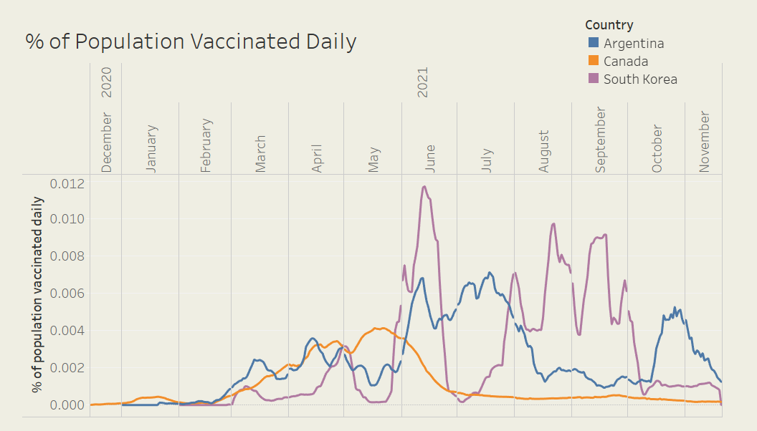
Visualization
Notes:
findings:
most people in Argentina had their vaccination in July & end of October
most people in Canada had their vaccination in April-May
most people in Korea had their vaccination in June, end of July-end of Sep
the effectiveness of vaccines loses over time, so we have to see how recent people have their vaccinations

Slide 12
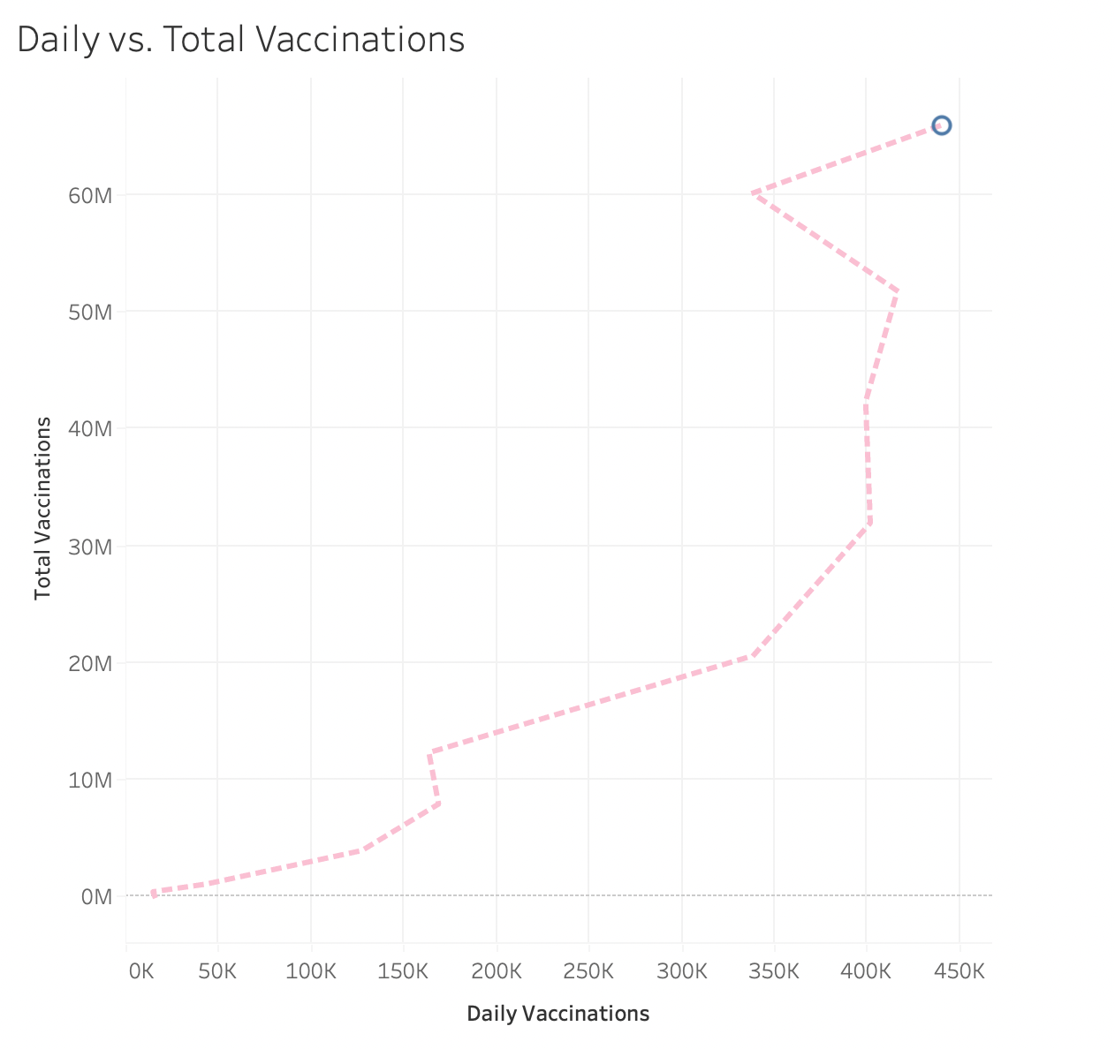
Argentina

Slide 13
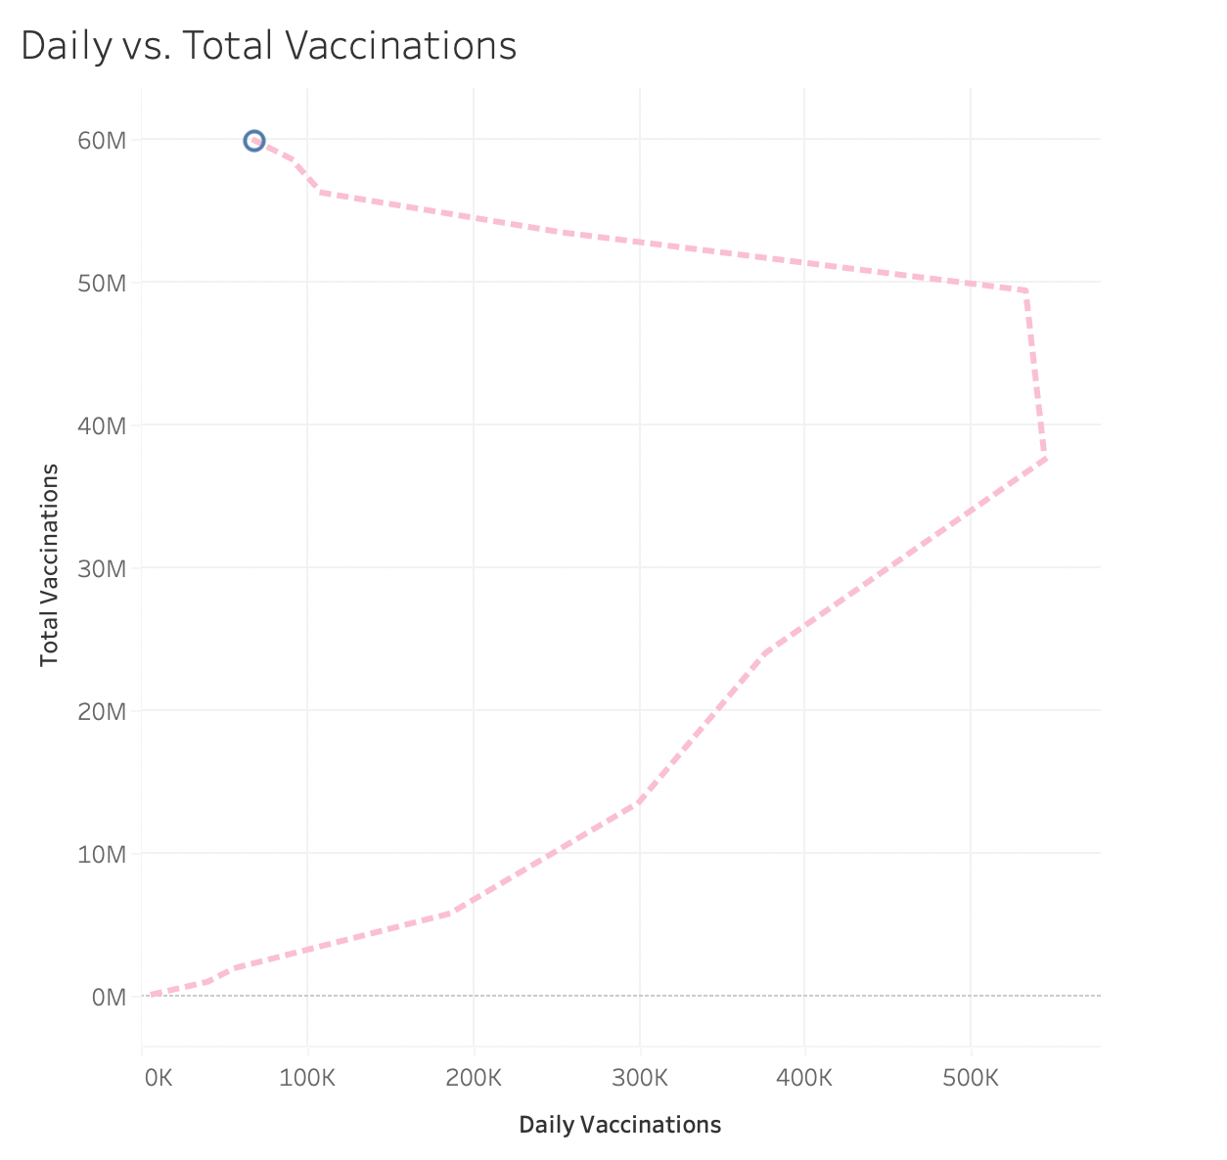
Canada

Slide 14
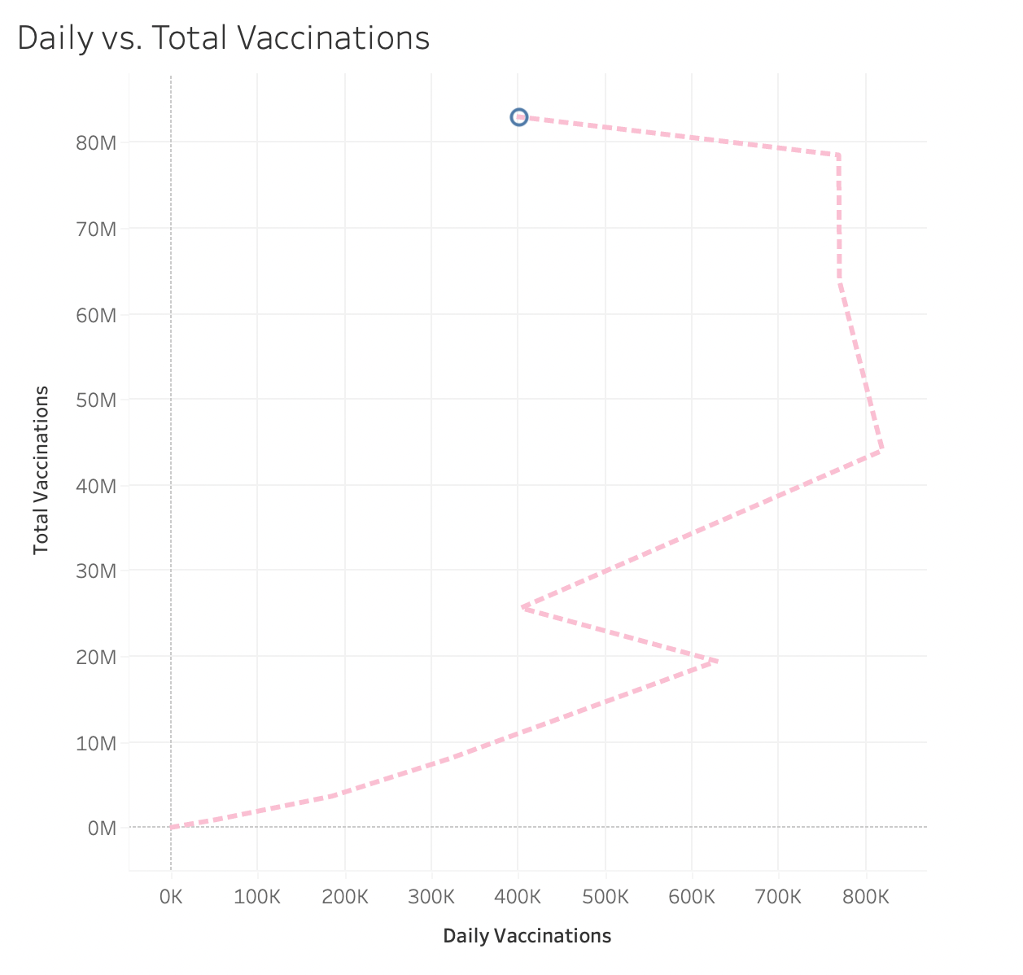
South Korea

Slide 15
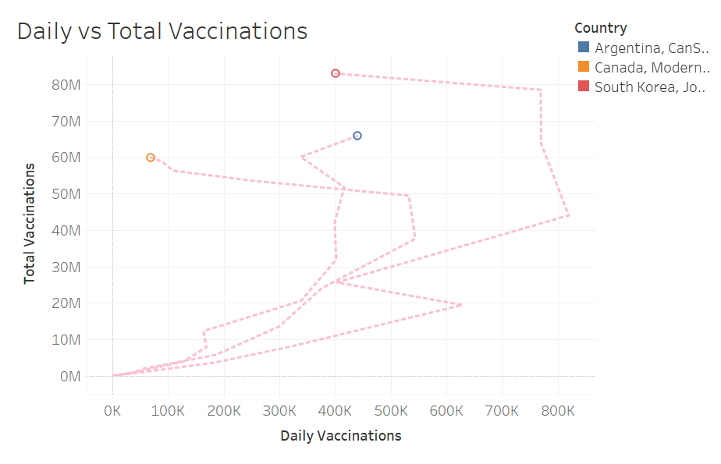
Comparison

Slide 16
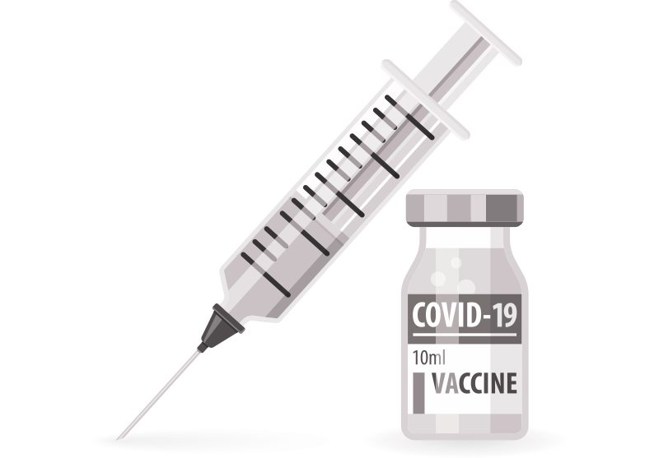
Question 2
How many individuals are fully vaccinated and partially vaccinated?

Slide 17
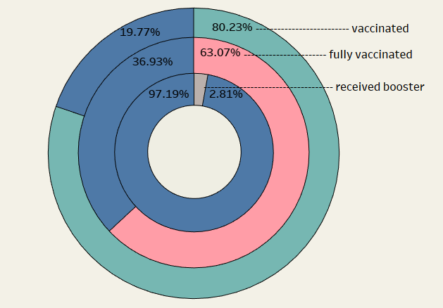
Argentina

Slide 18
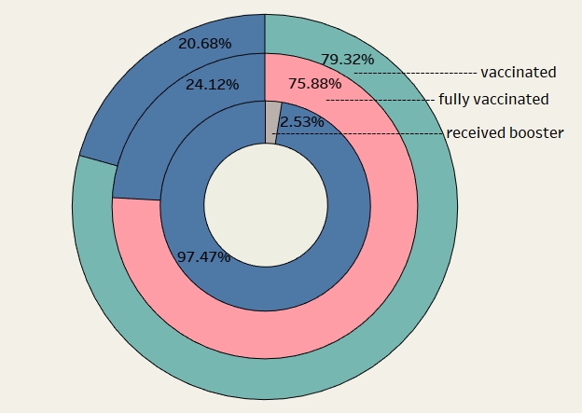
Canada

Slide 19
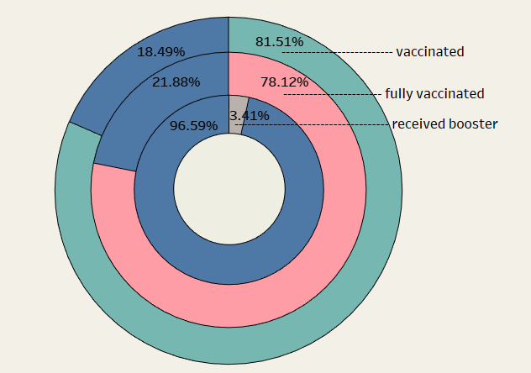
South Korea

Slide 20
Comparison
Argentina
Canada
South Korea

Slide 21

Question 3
How many more individuals are predicted to be vaccinated in the future?

Slide 22
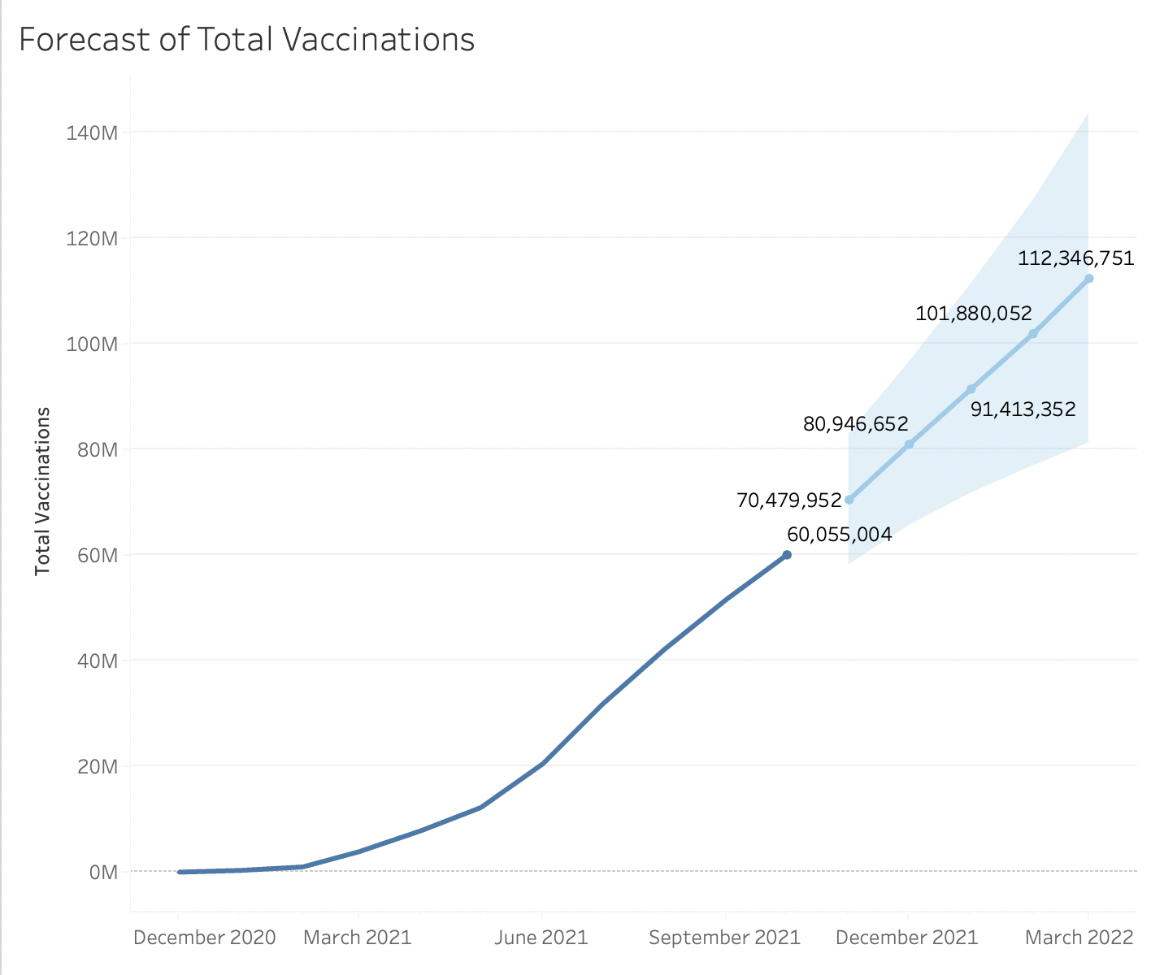
Argentina

Slide 23
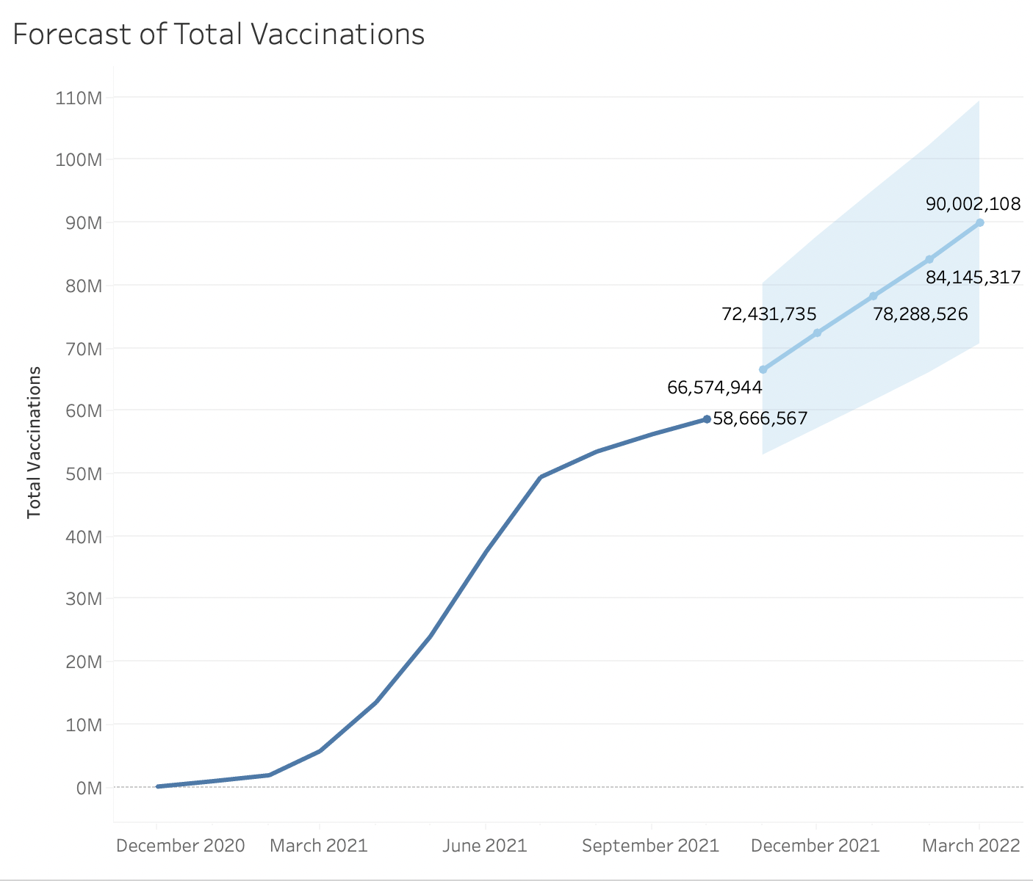
Canada

Slide 24
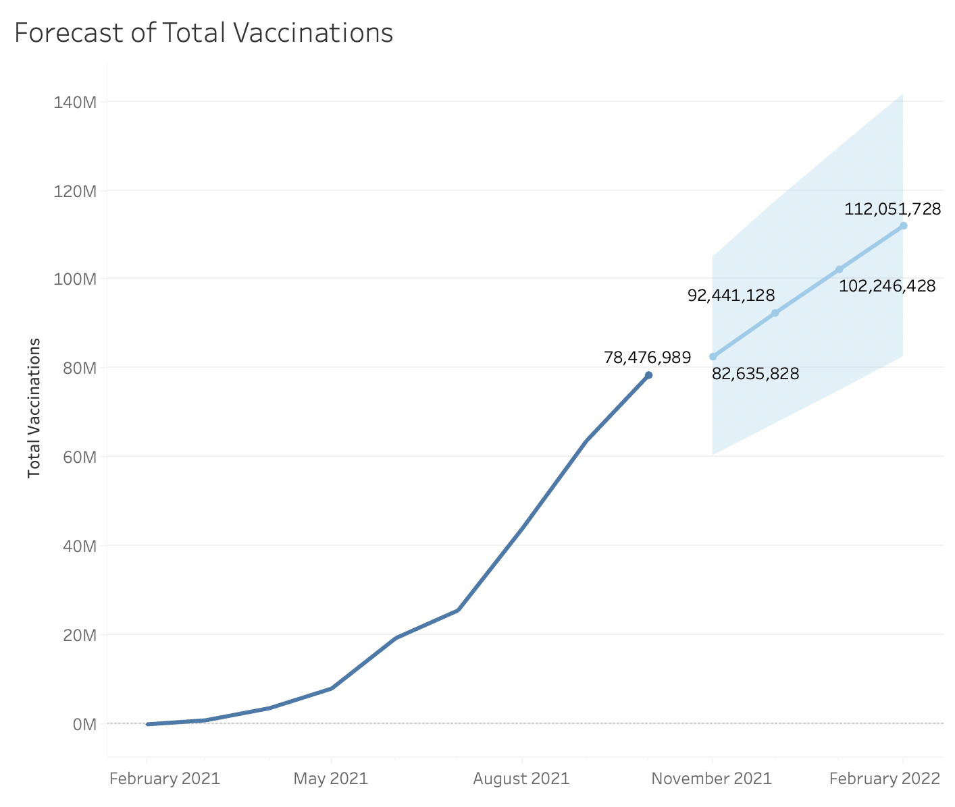
South Korea

Slide 25
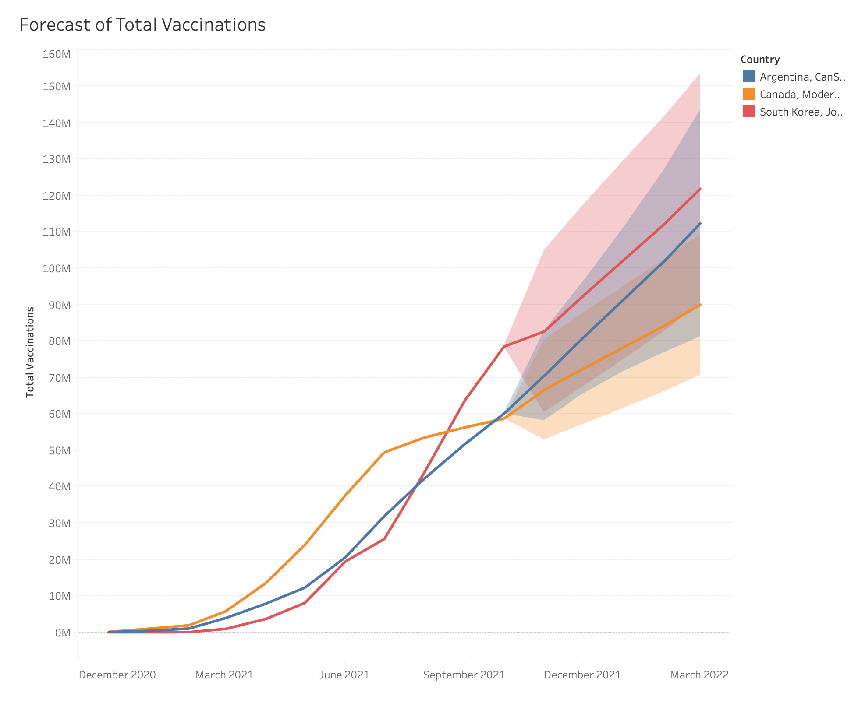
Comparison

Slide 26
Conclusion
Our Summary and Takeaways

Slide 27
Argentina Quick Stats
65,879,184
28,379,784
80.2%
Total vaccinations
Fully vaccinated individuals
Proportion of population vaccinated

Slide 28
Canada Quick Stats
59,935,961
28,833,278
79.3%
Total vaccinations
Fully vaccinated individuals
Proportion of population vaccinated

Slide 29
South Korea Quick Stats
82,927,648
40,452,376
81.5%
Total vaccinations
Fully vaccinated individuals
Proportion of population vaccinated

Slide 30
Recommendation
If Cabrera is going to travel in the next 1-2 months, we recommend him to travel to South Korea.
Around 78 % of individuals are fully vaccinated
Most people have had their vaccination during June to end of September
If Cabrera is going to travel after the next 2 months (after March 2022), we recommend him to travel to Argentina.
Although 63% of people are fully vaccinated in Argentina right now, more vaccinations are being administered to their citizens recently.
More daily vaccinations are occurring in the country right now.

Slide 31
Thank You!

